Slide 1
CYCLIST-AUTONOMOUS VEHICLE INTERACTION: ENHANCING ROAD SAFETY THROUGH AN AUGMENTED REALITY PROTOTYPE
by Cameron McDonald
2570726M

Slide 2
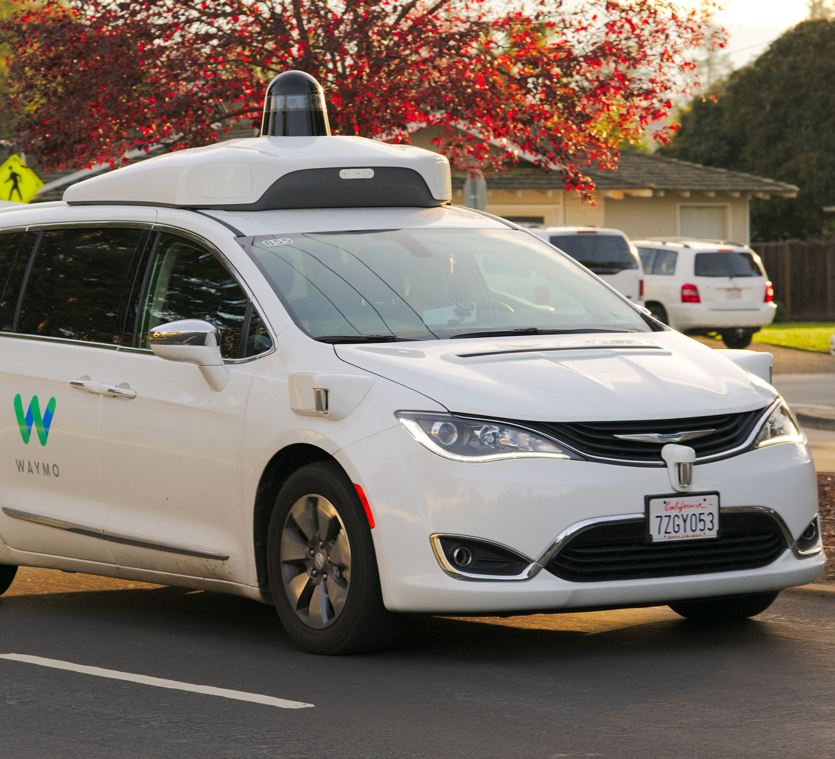
Introduction

Slide 3
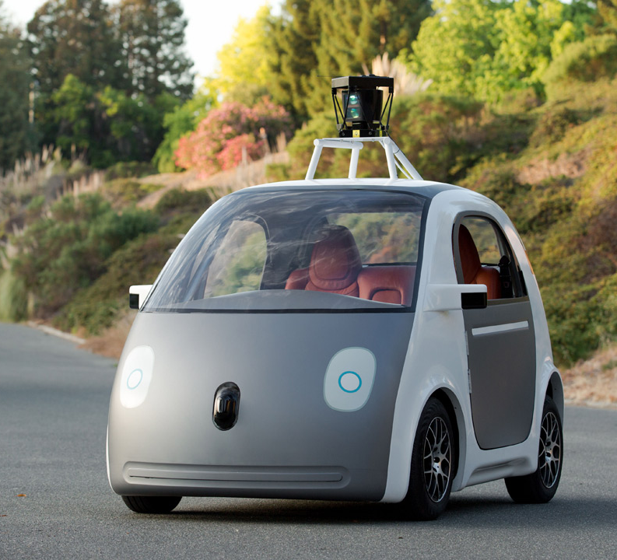
Background

Slide 4

Requirements

Slide 5
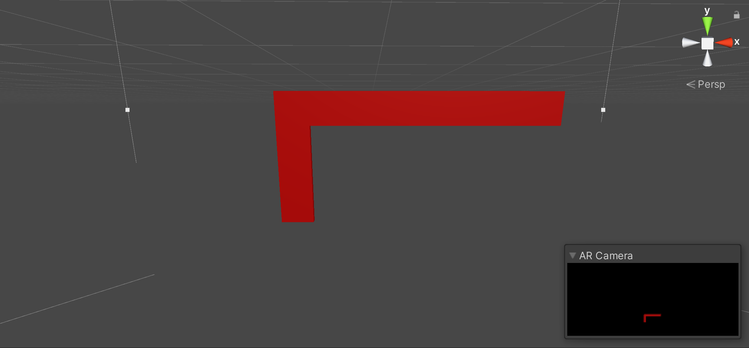



Design

Slide 6
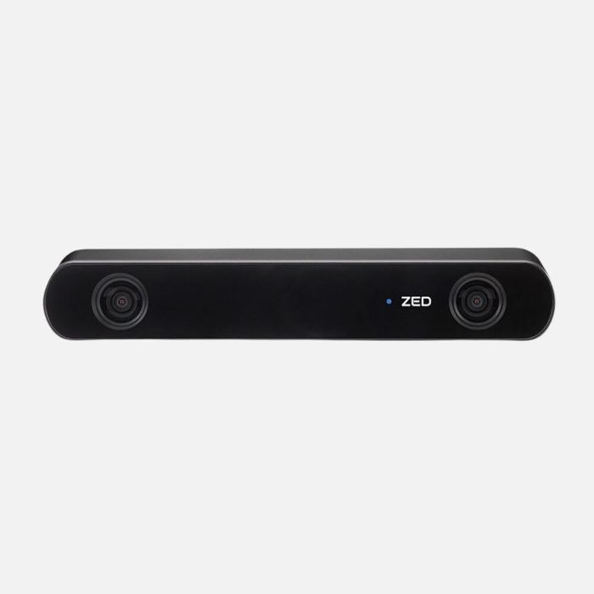
Implementation

Slide 7
Evaluation

Slide 8

Conclusion

